Slide 1
How EDA and multicollinearity affect the linear regression?
Student: Nabi Nabiyev
Subject: Statistical Analysis

Slide 2

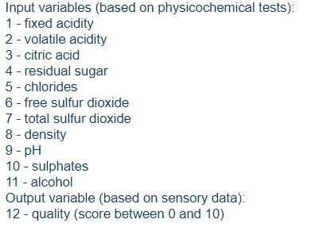
Dataset

Slide 3
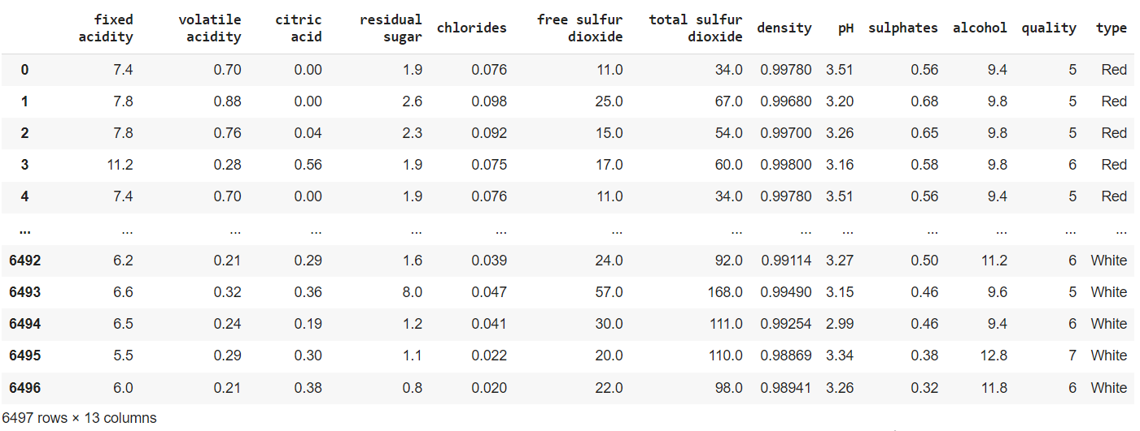
Overall view of the data

Slide 4
Steps for implementing MLR
Defining input (independent) and output (dependent) variables
Standardizing (normalizing) input variables
Model fitting
Model prediction
Accuracy estimation

Slide 5
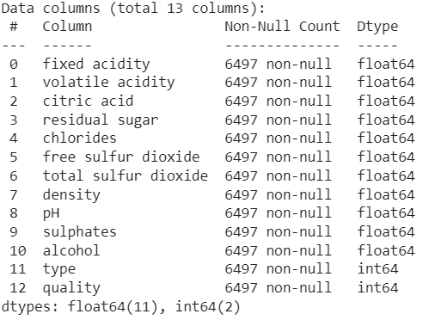
First step
As input variables, we take each feature except the quality, which will be our target. Here’s the type of each column:

Slide 6
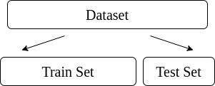
First step
All of the data is splitted into training and test datasets (75% and 25%, respectively)
Training dataset is used for training and educating the model
Test dataset is used for testing and evaluating the model

Slide 7
Second step
The most popular data scalers:
Standard Scaler (useful for features that follow normal distribution ; vulnerable towards outliers)
MinMax Scaler (useful when knowing upper and lower boundaries from domain knowledge)
Robust Scaler (useful when there are lots of outliers in the data)

Slide 8
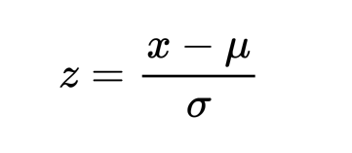
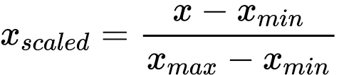
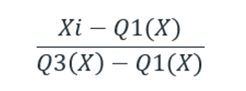
Second step
Standard Scaler
MinMax Scaler
Robust Scaler

Slide 9
Initially, I will create a baseline model without performing any EDA
So, I will use Standard Scaler as the typical choice for normalization.

Slide 10

Second step
We can only implement standardization based on the mean and variance of the training data. Otherwise, our model gets some information about the test dataset, which we, of course, don’t want it to know

Slide 11

Third and fourth step
MLR is defined and gets fit on training data. After, we enable the model to predict the target of the training data by himself. Subsequently, model is given a challenge to predict the target of the test data, the part of the data that it didn’t see before

Slide 12
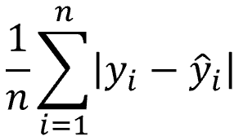
Fifth step
actual value
MAE (Mean Absolute Error)
predicted value

Slide 13
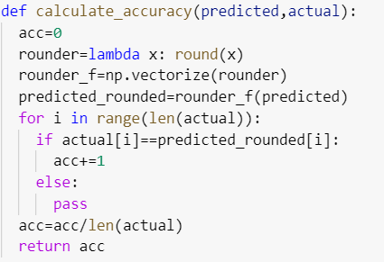
Fifth step
Custom function that calculates the accuracy by rounding up the predicted values to the nearest whole numbers, and then computing the percentage of right matches

Slide 14

Fifth step
Before
After

Slide 15
Results of metrics
Training MAE: 0.5641
Training accuracy: 53.34%
Testing MAE: 0.5818
Testing accuracy: 52.92%

Slide 16
Now let’s see how EDA can help us with understanding of the data and improving the model

Slide 17
Firstly, let’s plot the histograms of each continuous variable to identify the distribution

Slide 18
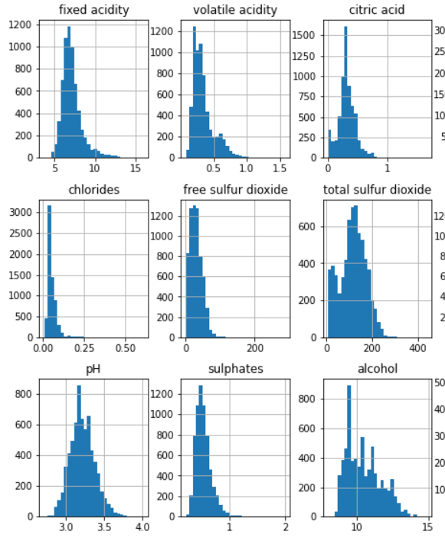
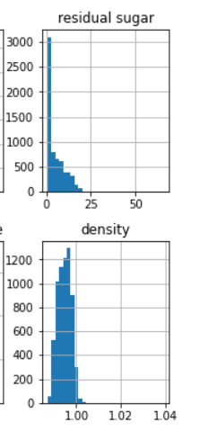
Distribution of the data
Histograms of almost all of the features are normally distributed. However, most of them are positively (right) skewed

Slide 19
Secondly, let’s plot the box plots to visualize the presence of outliers

Slide 20
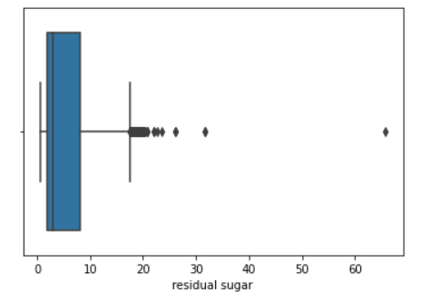
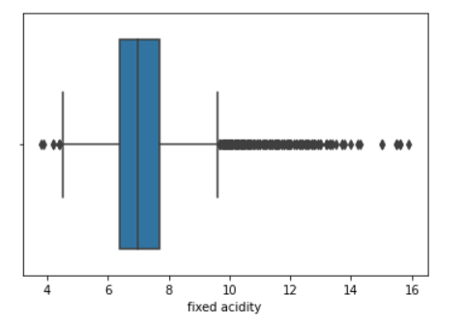
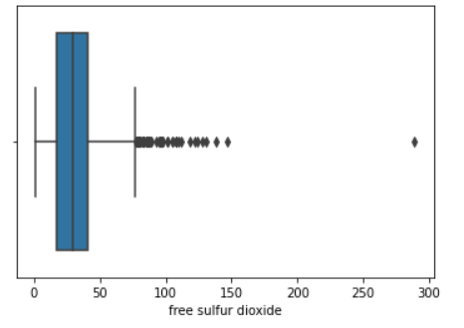
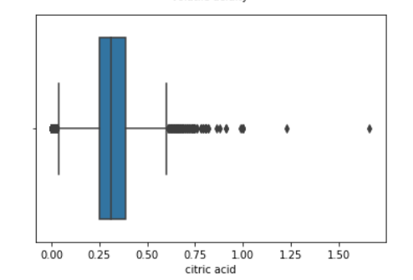
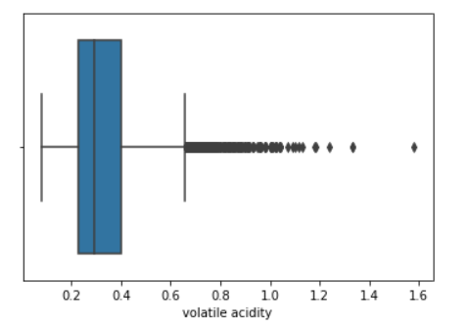
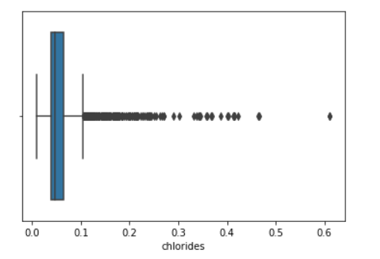
Distribution of the data

Slide 21
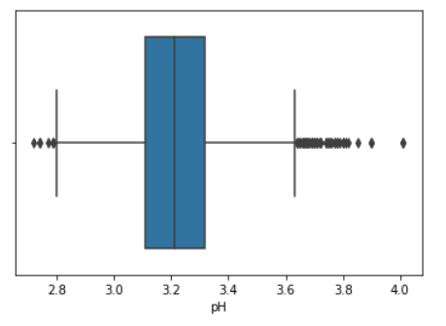
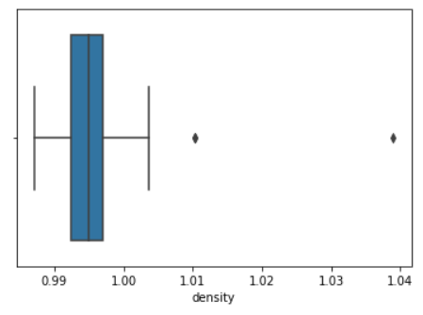
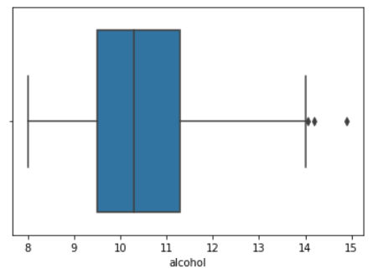
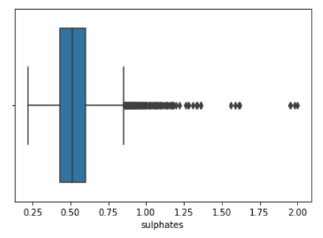
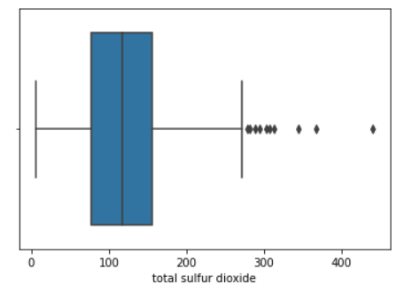
Distribution of the data

Slide 22
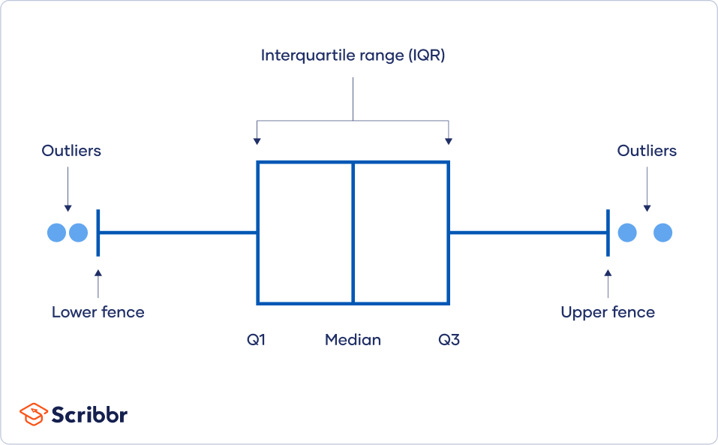
How to detect outliers in boxplots?

Slide 23
From the boxplots and histograms, we can see that
Certain variables like volatile acidity, residual sugar, chlorides and sulphates are right skewed and they contain lots of outliers in the skewed (right) part
Citric acid and fixed acidity contain the highest amount of outliers among other variables, and they are not perfectly skewed to the right. Moreover, outliers are detected in both parts (left and right) of the distribution

Slide 24
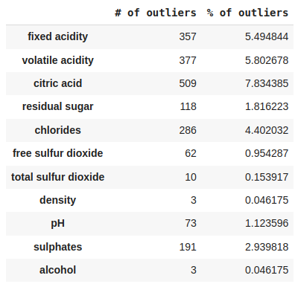
Outlier share for each variable
Data point is an outlier if it’s
< Q1 - 1.5*IQR
> Q3 + 1.5*IQR
in which IQR = Q3-Q1

Slide 25
Dealing with outliers
Dropping the outliers from the data
Transforming the variables (square root, cubic root, inverse transform, log)
Using models and scalers that are insensitive to outliers (HuberRegressor, RobustScaler)

Slide 26
I decided to experiment with various transformations and found out that…
Some transformations decrease the amount of outliers of one variable, while increasing it in another
Cubic root transformation is the most effective for right-skewed data, where outliers are located on the one side of distribution (1st point in 23rd slide)
However, cubic root transformation increases the outlier share in variables that are not completely right-skewed (2nd point in 23rd slide)

Slide 27
Now, let’s implement 2nd model and compare it to the baseline model

Slide 28
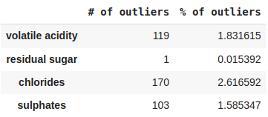
2nd approach
Using cubic root transformation to right-skewed variables
After
Before

Slide 29
2nd approach
Using Robust Scaler instead of Standard Scaler to be more resilient towards other variables that had outliers but weren’t transformed
Other steps are the same as in the baseline model
Baseline model
2nd approach
Training MAE: 0.5641
Training accuracy: 53.34%
Testing MAE: 0.5818
Testing accuracy: 52.92%
MAE: 0.5606
Train accuracy: 53.81%
MAE: 0.5788
Test accuracy: 53.47%

Slide 30
As we can see, EDA helped us to identify problems within variables. We also increased the accuracy of a MLR even though it’s just 1%

Slide 31
Let’s dig deeper and see whether each type of wine has equal patterns in the psychochemical tests when determining the quality

Slide 32
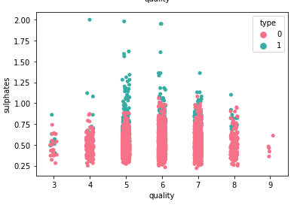
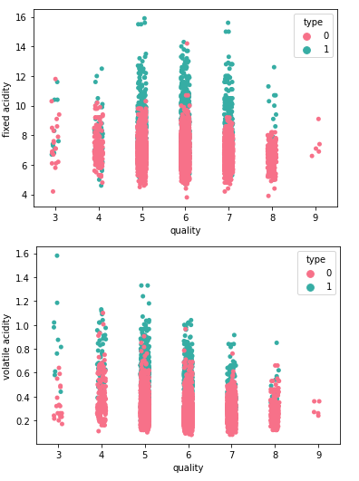
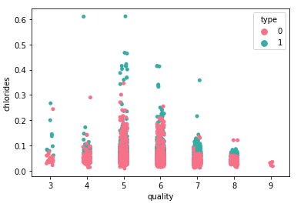
Strip plots
Red wine - type 1
White wine - type 0

Slide 33
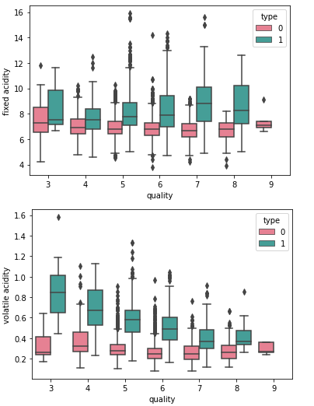
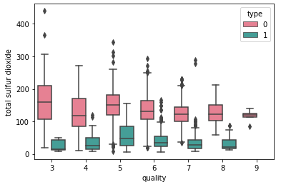
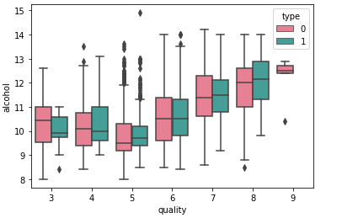
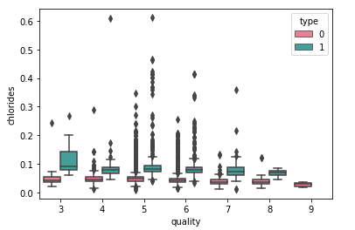
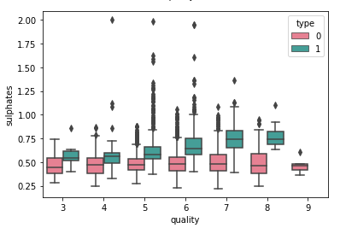
Box plots for each quality and wine type

Slide 34
Patterns are not the same for white and red wine. It makes sense to create separate model for each wine type

Slide 35
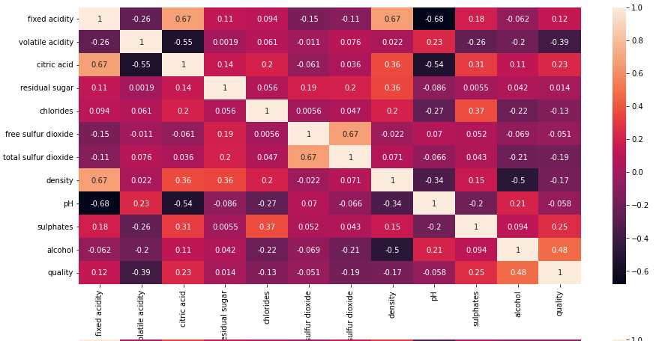
Correlation matrix (red wine)

Slide 36
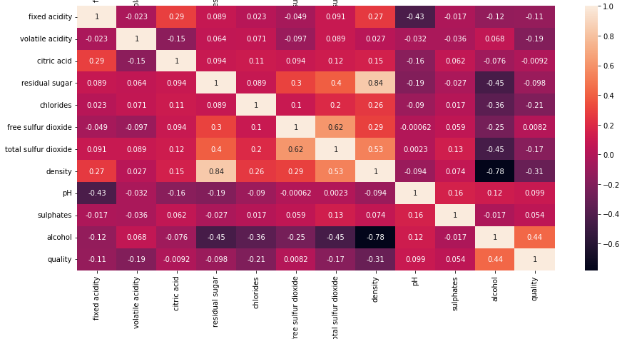
Correlation matrix (white wine)

Slide 37
Strongly correlated relationships
White wine:
density & alcohol: -0.78
density & residual sugar: 0.84
total sulfur dioxide & free sulfur dioxide: 0.62
Red wine:
total sulfur dioxide & free sulfur dioxide: 0.67
pH & fixed acidity: -0.68
citric acid & fixed acidity: 0.67
density & fixed acidity: 0.67

Slide 38
Multicollinearity
Multicollinearity is a statistical concept where independent variables are highly correlated with each other. High correlation shows that independent variables are linearly dependent on each other, which can spoil the model. Ideally, models, especially linear ones, depend on the fact that independent variables don’t have any sort of relationship with each other, except the target variable.
Ideally, multicollinearity is defined when correlation (Pearson’s coefficient) is more than 0.7. However, I lowered this threshold to 0.65 to fully see the picture

Slide 39
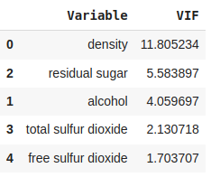
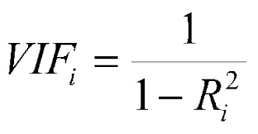
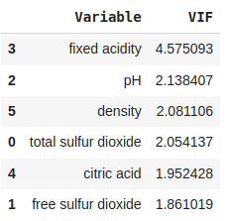
How to measure multicollinearity?
white wine
Variance Inflation Factor
R2 score
Only variables which have high correlation
red wine

Slide 40
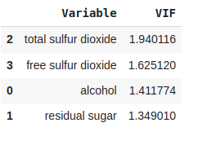
How to measure multicollinearity?
VIF equal to 1 - no linear relationship
VIF is between 1 and 5 - moderate linear relationship
VIF is more than 5 - high linear relationship
before dropping
after dropping
We drop the variable with highest VIF (if it’s more than 5), and then calculate VIF for the remaining variables again. This procedure is repeated until no variable will have a high VIF score

Slide 41
Collinearity suggests us to drop density column for white wine data

Slide 42
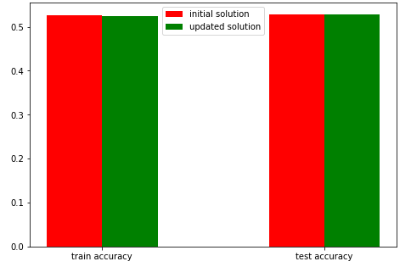
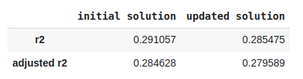
Collinearity doesn’t affect the accuracy
Here’s the accuracy metrics for 2nd model that got fit exclusively on white wine data, and the same model that received white wine data without density column
Baseline
2nd approach
Training MAE:
0.5849
0.5835
Training accuracy:
52.32%
52.51%
Testing MAE:
0.5803
0.5813
Testing accuracy:
52.89%
52.89%

Slide 43
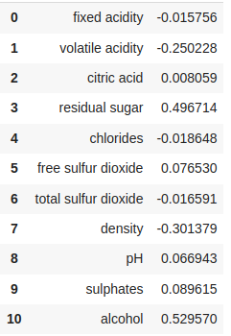
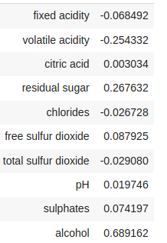
However, it affects the interpretation of the model and its coefficients
With multicollinearity
Without multicollinearity

Slide 44
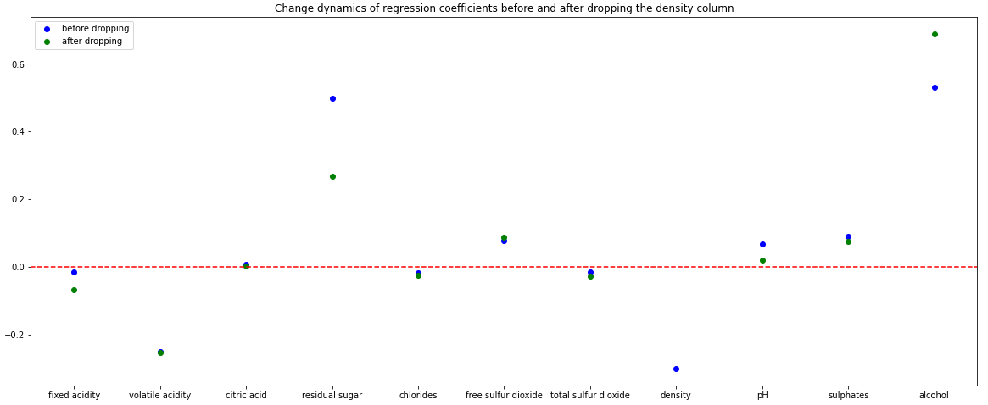
Even the small change in coefficients can affect the overall interpretation of the model

Slide 45
The major change happened with residual sugar and alcohol variables. Before getting rid of multicollinearity, they had the same impact on the model. However, now, the impact of residual sugar decreased while the role of alcohol in determining the quality of the wine increased.

Slide 46
Now let’s implement the approach we’ve discovered through EDA (cubic root, separate model for each type of wine,dropping density column for white wine data) and compare the results with the baseline model

Slide 47
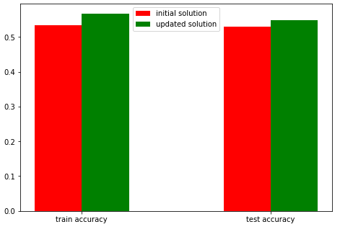
Final comparison
Mean training accuracy
56.77%
Mean training MAE
0.5381
Mean testing accuracy
54.82%
Mean training MAE
0.5537
Evaluation metrics for the baseline model are in 15th and 29th slides

Slide 48
Conclusion
Even though the accuracy of the model was increased by 2-3% on average, the biggest goal that we achieved through EDA was understanding of the data and how hidden patterns can influence the model in various ways. By knowing this information, better models and solutions can be proposed. The main aim of this topic is the response to the increasing number of data professionals who only focus on the machine learning part of the data science workflow, and completely ignore the EDA and data preprocessing part

Slide 49
Thank you!

Slide 50
Image references
2nd slide - https://en.wikipedia.org/wiki/Wine
6th slide - https://www.baeldung.com/cs/train-test-datasets-ratio
11th slide - https://medium.com/@minhsang.08clc/if-time-series-prediction-can-be-used-to-predict-stock-prices-32249af7233a
22th slide - https://www.scribbr.com/statistics/outliers/

